Slide 1

图算法
Yongcai Wang
Renmin University of China

Slide 2

主要内容
Concept of Graphs
Review of DFS
Application of DFS
Review of BFS
DFS Algorithm
Complexity
Detection of cycles
Examples of graphs
Graph terminologies
BFS algorithm
Representation of Graphs
Parenthesis Lemma
Detection of Strongly Connected Components
Bridges and two-edge connectivity
Testing bipartite-ness

Slide 3
Graphs
Internet的图
(circa 1999…it’s a lot bigger now…)

Slide 4
Graphs
论文引用关系图academic papers

Slide 5
Graphs
理论计算机领域合作者关系图

Slide 6
Graphs
航空路线图

Slide 7
Graphs
算法复杂性NP-hard问题关系图

Slide 8
Graphs
Debian linux依赖关系图（部分）

Slide 9
Graphs
世界土豆贸易网络

Slide 10
Graphs
太平洋中的食物链

Slide 11
Graphs
大脑中的神经链接关系图

Slide 12
Graphs
There are a lot of graphs.
We want to answer questions about them.
Efficient routing?
Community detection/clustering?
This is what we’ll do for the next several lectures.

Slide 13
无向图
2
1
Has vertices and edges
V is the set of vertices
E is the set of edges
Formally, a graph is G = (V,E)
Example
V = {1,2,3,4}
E = { {1,3}, {2,4}, {3,4}, {2,3} }
3
G = (V,E)
4
The degree of vertex 4 is 2.
There are 2 edges coming out.
Vertex 4’s neighbors are 2 and 3

Slide 14
有向图
2
1
Has vertices and edges
V is the set of vertices
E is the set of DIRECTED edges
Formally, a graph is G = (V,E)
Example
V = {1,2,3,4}
E = { (1,3), (2,4), (3,4), (4,3), (3,2) }
3
G = (V,E)
4
The in-degree of vertex 4 is 2.
The out-degree of vertex 4 is 1.
Vertex 4’s incoming neighbors are 2,3
Vertex 4’s outgoing neighbor is 3.

Slide 15
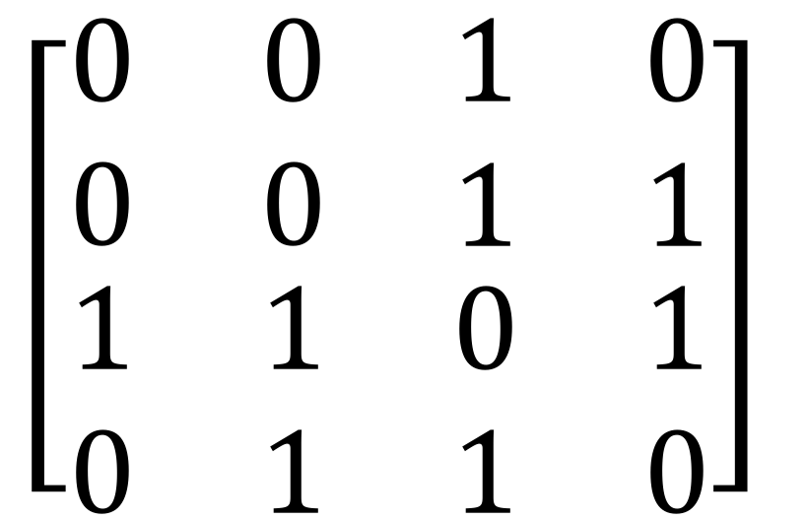
图的表示
Option 1: adjacency matrix
2
1 2 3 4
1
$$\left[\begin{matrix}\begin{matrix}0 & 0 \\ 0 & 0\end{matrix} & \begin{matrix}1 & 0 \\ 1 & 1\end{matrix} \\ \begin{matrix}1 & 1 \\ 0 & 1\end{matrix} & \begin{matrix}0 & 1 \\ 1 & 0\end{matrix}\end{matrix}\right]$$
3
4
1 2 3 4

Slide 16
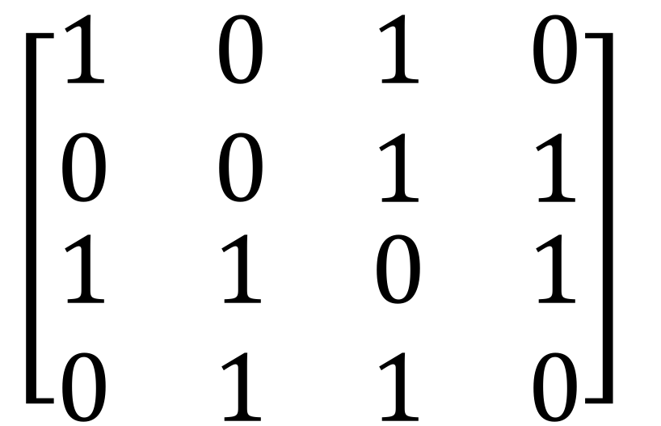
有自环无向图邻接矩阵
Option 1: adjacency matrix
2
1 2 3 4
1
$$\left[\begin{matrix}\begin{matrix}1 & 0 \\ 0 & 0\end{matrix} & \begin{matrix}1 & 0 \\ 1 & 1\end{matrix} \\ \begin{matrix}1 & 1 \\ 0 & 1\end{matrix} & \begin{matrix}0 & 1 \\ 1 & 0\end{matrix}\end{matrix}\right]$$
3
4
1 2 3 4

Slide 17
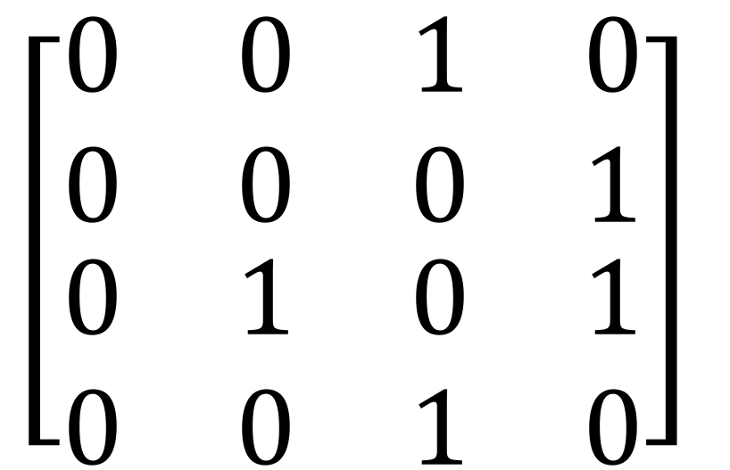
有向图邻接矩阵
2
Option 1: adjacency matrix
Destination
1 2 3 4
1
$$\left[\begin{matrix}\begin{matrix}0 & 0 \\ 0 & 0\end{matrix} & \begin{matrix}1 & 0 \\ 0 & 1\end{matrix} \\ \begin{matrix}0 & 1 \\ 0 & 0\end{matrix} & \begin{matrix}0 & 1 \\ 1 & 0\end{matrix}\end{matrix}\right]$$
3
4
1 2 3 4
Source

Slide 18
邻接表
Option 2: adjacency lists.
2
1
2
3
4
1
3
3
4
1
2
4
4
3
3
How would you modify this for directed graphs?
2
4’s neighbors are 2 and 3

Slide 19
两种表示的异同
顶点也可以存储其它信息
Attributes (name, IP address, …)
Helper info for algorithms that we will perform on the graph
需要支持如下操作:
Edge Membership: Is edge e in E?
Neighbor Query: What are the neighbors of vertex v?

Slide 20
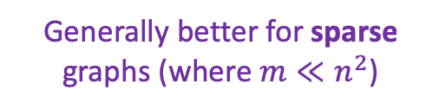
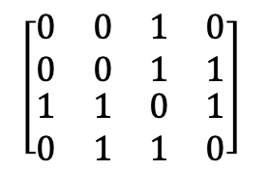
计算时间对比
Generally better for sparse graphs (where $m≪n^{2}$)
1
2
3
4
Say there are n vertices and m edges.
$$\left[\begin{matrix}\begin{matrix}0 & 0 \\ 0 & 0\end{matrix} & \begin{matrix}1 & 0 \\ 1 & 1\end{matrix} \\ \begin{matrix}1 & 1 \\ 0 & 1\end{matrix} & \begin{matrix}0 & 1 \\ 1 & 0\end{matrix}\end{matrix}\right]$$
3
4
1
2
3
4
3
2
Edge membership
Is e = {v,w} in E?
O(1)
O(deg(v)) or O(deg(w))
Neighbor query
Give me a list of v’s neighbors.
O(n)
O(deg(v))
Space requirements
O(n²)
O(n + m)
We’ll assume this representation for the rest of the class

Slide 21
路径和环
A path in a graph or digraph is a sequence of vertices ⟨v₀,...,v_{k}⟩ such that (v_{i−1},v_{i}) is an edge for i = 1,...,k.
A path is simple if all vertices and all the edges are distinct.
A cycle is a path containing at least one edge and for which v₀ = v_{k}.
A cycle is simple if its vertices (except v₀ and v_{k}) are distinct, and all its edges are distinct.
A graph or digraph is said to be acyclic if it contains no simple cycles.
An acyclic connected graph is called a free tree or simply tree for short.

Slide 22
Illustration of common graph terms
acyclic connected undirected graph
Directed acyclic graph

Slide 23
主要内容
Concept of Graphs
Review of DFS
Application of DFS
Review of BFS
DFS Algorithm
Complexity
Detection of cycles
Examples of graphs
Graph terminologies
BFS algorithm
Representation of Graphs
Parenthesis Lemma
Detection of Strongly Connected Components
Bridges and two-edge connectivity
Testing bipartite-ness

Slide 24
Data structure in DFS
Marks for each vertex:
undiscovered, discovered, finished
Auxiliary arrays:
Discovery time: d[u], the time when vertex u was discovered
Finish time: f[u], the time when vertex u is finished processing
Predecessor pointer: p[u], the vertex that discovers u. Each edge of the form (p[u], u) is a tree edge in the DFS recursion tree.

Slide 25
initialization
Search from u
u has been discovered
discovered time of u
discovered neighbor of u
u is parent of v
Search from v
u is finished
u’s finishing time

Slide 26
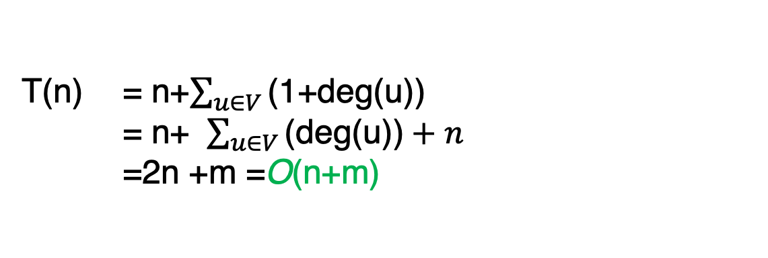
The running time
The main DFS procedure runs in O(n+m) time.
Each vertex u can be processed in O(1 + deg(u)) time (the “+1” is needed in case the degree is 0).
Thus the total time used in the procedure is
T(n) = n+$\sum_{u∈V}{\text{(1+}\text{deg}\text{(}\text{u}\text{))}}$
= n+ $\sum_{u∈V}{\text{(}\text{deg}\text{(}\text{u}\text{))}}+n$
=2n +m =O(n+m)
DFS的空间复杂度是多少？
用堆栈存储待递归访问节点：O(n)
如果用邻接矩阵的数据结构，DFS的时间复杂度是多少？
O(n²)，每个节点上花费O(n)访问邻居

Slide 27
Parenthesis Lemma and Edge Types
Lemma: (Parenthesis Lemma) Given a graph G = (V, E) (directed or undirected), and any DFS tree for G and any two vertices u, v ∈ V :
u is a descendant of v iff [d[u],f[u]] ⊆ [d[v],f[v]].
u is an ancestor of v iff [d[u],f[u]] ⊇ [d[v],f[v]].
u and v are unrelated (in terms of ancestor/descendant) iff [d[u], f [u]] and [d[v], f [v]] are disjoint.

Slide 28
Parenthesis Lemma: An example
a
d
b
f
e
c
g
1/
10
11/
14
a
d
6/
5
9
2/
b
f
e
12/
13
c
g
7/
3/
8
4

Slide 29
Edge Types in DFS Tree in Digraph
Tree edges: edges in the DFS tree
Forward edges: (u, v) where v is a proper descendant of u in the tree
Back edges: (u, v) where v is an ancestor of u in the tree.
Cross edges: (u, v) where u and v are not ancestors or descendants of one another

Slide 30
Edge Types in DFS Tree in undirected graph
Tree edges: edges in the DFS tree
Back edges: (u, v) where u is either a proper ancestor or a proper descendant of v.
e

Slide 31
练习
给出下图的DFS forest，节点上给出d(u), f(u)

Slide 32
答案

Slide 33
练习：画出下图的DFS forest

Slide 34
答案

Slide 35
主要内容
Concept of Graphs
Review of DFS
Application of DFS
Review of BFS
DFS Algorithm
Complexity
Detection of cycles
Examples of graphs
Graph terminologies
BFS algorithm
Representation of Graphs
Parenthesis Lemma
Detection of Strongly Connected Components
Bridges and two-edge connectivity
Testing bipartite-ness

Slide 36
Application of DFS: Detection of Cycles in Digraph
A directed acyclic graph, or DAG, is a directed graph that has no cycles.
Let us consider the problem of determining whether a digraph is acyclic. We are given a directed graph G = (V,E), and we wish to determine whether G contains a cycle. If so, G is not a DAG.
A simple algorithm based on DFS:
If a digraph G has a cycle, then any DFS forest of G (i.e., no matter what order the vertices are visited) has a back edge.

Slide 37
Why DFS can detect cycle?
a
d
b
f
e
c
g
From the Parenthesis Lemma, if u is an ancestor of v then we have [d[v],f[v]] ⊂ [d[u],f[u]].
If (u,v) is a tree edge or forward edge then f[u] > f[v].
If (u,v) is a cross edge, there must be d[u] > d[v], and f[u]>f[v]
For all these three edge types (tree, forward, and cross), they cannot form a cycle.
Only for back edges do we have f[u] < f[v], and therefore in order to form a cycle we need to have at least one back edge.

Slide 38
DFS to detect cycle in digraph
If (u,v) is a back edge, there should be [d[u],f[u]] ⊂ [d[v],f[v]].
We do this on the fly as DFS is running
A back edge goes from a vertex u to an ancestor v. Such an ancestor must have been discovered, but not yet finished.
只有当一个祖先节点的所有子孙结点探索完成时，这个祖先节点才会finish。

Slide 39
detect cycle in digraph
DFSvisit(u) {
mark[u] = discovered
d[u] = ++time
for each (v in Adj(u)) {
if (mark[v] == undiscovered) {
pred[v] = u
DFSvisit(v)
}
else if (mark[v] != finished) {
output "G has a cycle!"
}
}
mark[u] = finished
f[u] = ++time
}
如果v是已经discover，但是还没有finish，那么它是u的祖先节点，(u,v)是backedge

Slide 40
Strongly Connected Components (SCC)
A digraph G = (V,E) is said to be strongly connected if for every vertex u and v there is a path from u to v and a path from v to u.
SCC partition is to partition V into strongly-connected components of G.
If the vertices within each strong component are collapsed into a single vertex, the resulting digraph is called the component DAG.

Slide 41
Detect SCC by DFS
Lemma (Reachability Lemma): If DFSvisit is started at a vertex u, it will terminate precisely when all the vertices reachable from u have been visited.
Lemma: If C and C′ are two strong components, and there is an edge from a vertex in C to a vertex in C′, then the highest finish time in C is bigger than the highest finish time in C′.
C
u
C′
C
u
C′
IF DFS firstly encounters u in C’, the DFS gets stuck in C’. C is in another DFS tree with higher finishing time
If DFS firstly encounters u in C, u is ancestor of C’, so u has higher finishing time

Slide 42
DFS to detect SCC
Lemma: the vertex that receives the highest finish time in a DFS must lie in a source vertex of the component DAG.
This lemma is equivalent to saying that the strong components can be linearly arranged in decreasing order of their highest finish times.
Every edge in the component DAG will go from a later finished component in the linear order to an earlier one.
Finish latest
Finish earliest

Slide 43
DFS to detect SCC
There exists an O(n + m)-time DFS algorithm for computing strongly connected components.
The idea:
DFS in a leaf of component DAG. （怎么找到叶子模块？）
Delete all these vertices and repeat the process.
Each subtree of the DFS forest is a SCC
Finish latest
Finish earliest

Slide 44
怎么找到叶子模块
在原有向图中，叶子模块的节点的finishing time是最早的。
我们把图中的边反向后，做DFS，则finishing time最晚的那些点，对应着原图DFS的叶子模块。

Slide 45
DFS to detect SCC: Algorithm
Given G, compute G^{R}, it can be done in O(n + m) time.
Run DFS(G^{R}) and label each vertex of G with the finish time of the corresponding vertex of G^{R}.
Sort the vertices of G in decreasing order of finish times (Bucket sort in O(n)).
Run DFS(G), but in the outermost loop, whenever we need to find a new vertex to start DFSvisit, take the vertex with the highest finish time.
Each subtree of the DFS forest will be a strong component.

Slide 46
5
6
4
11
17
14
12
18
15
DFS(G^{R})

Slide 47
主要内容
Concept of Graphs
Review of DFS
Application of DFS
Review of BFS
DFS Algorithm
Complexity
Detection of cycles
Examples of graphs
Graph terminologies
BFS algorithm
Representation of Graphs
Parenthesis Lemma
Detection of Strongly Connected Components
Bridges and two-edge connectivity
Testing bipartite-ness

Slide 48
Higher-Order Graph Connectivity in Undirected Graphs
Bridge: Any edge whose removal results in a disconnected graph
2-Edge Connected: A graph is 2-edge connected if it contains no bridges.
Cut Vertex: Any vertex whose removal results in a disconnected graph.
Biconnected: A graph is biconnected if it contains no cut vertices

Slide 49
Finding Bridges through DFS
An intuitive way of finding bridges is:
“to delete each edge and then apply DFS to determine whether the resulting graph remains connected.”
This would take O(m(n + m)) time.
It is possible to identify all the bridges with a single application of DFS in O(n + m) time
We assume that G is connected, which has a single DFS tree.
DFS tree consists of two types of edges:
Tree edges.
Back edges.

Slide 50
Find bridges
We will present an O(n + m)-time algorithm for computing all the bridges of an undirected graph.
Menger‘s theorem: in a finite graph, the size of a minimum cut set is equal to the maximum number of disjoint paths that can be found between any pair of vertices.
Property for 2-edge connected graphs: between every pair of distinct vertices, there are at least two edge-disjoint paths between them.
Property for biconnected graph: for every pair of edges there is a simple cycle that contains both edges.

Slide 51
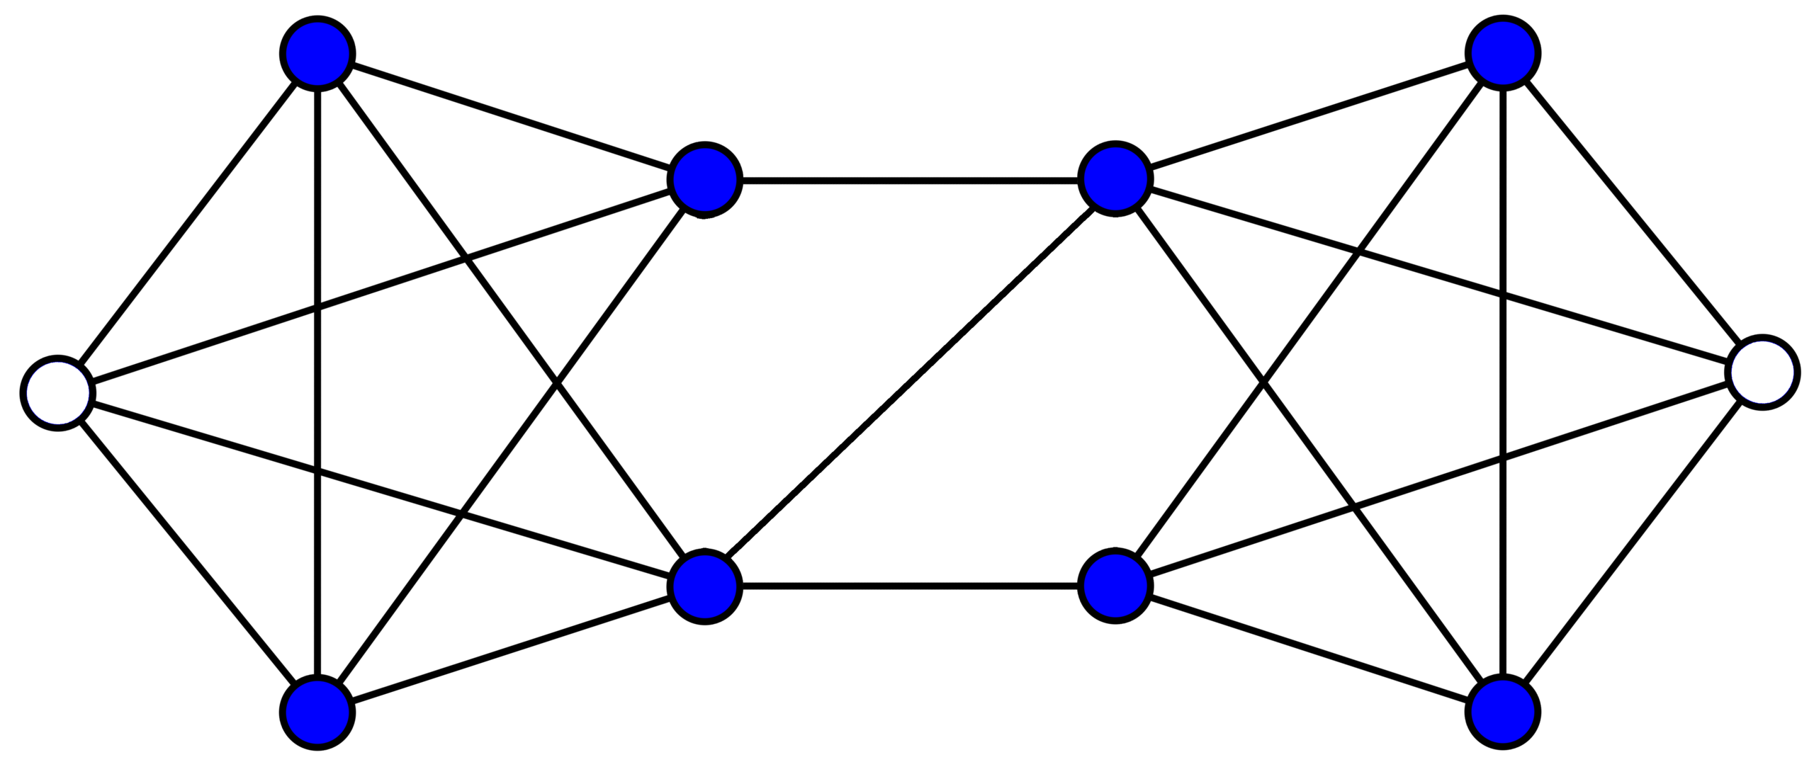
Menger‘s theorem
Cardility of minimum cut set: 2
The maximum number of disjoint paths between any pair of vertices: 2

Slide 52
Idea of Finding Bridges through DFS
Suppose that we are currently processing a vertex u in DFSvisit. We see an edge (u,v) going to a neighbor v of u.
If this edge is a back edge, it cannot be a bridge because the tree edge between u and v provides a second path.
We limit consideration to when (u,v) is a tree edge. We keep track of the back edges in the subtree rooted at v.

Slide 53
Idea of Finding Bridges through DFS
Lemma: An edge (u,v) is a bridge if and only if it is a tree edge and (assuming that u is the parent of v) there is no back edge within v’s subtree that leads to a vertex whose discovery time is strictly smaller than v’s discovery time.
How can we design an algorithm that tests this condition?
We will introduce an auxiliary quantity, which will be computed as the DFS runs. We define:
Low[u] = min(d[u], min{d[w] : for back edge (v, w) where v is a descendant of u}).

Slide 54
Finding Bridges by DFS
Low[u] = min(d[u], min{d[w] : for back edge (v, w) where v is a descendant of u}).
Intuitively, Low[u] is the closest to the root that you can get in the tree by taking any one back edge from either u or any of its descendants.
“Low”: means low discovery time, but is generally higher in the tree.
a
b
Low[u] = ?
Low[u] = d(b)

Slide 55
How to compute Low[u]?
Suppose that we are performing DFS on the vertex u.
Back edge (u, v): Low[u] = min(Low[u], d[v]). Explanation: We have detected a new back edge coming out of u. If this goes to a lower d-value than the previous back edge then make this the new Low (see Figure).

Slide 56
How to compute Low[u]?
Tree edge (u,v): Low[u] = min(Low[u],Low[v]). Explanation: Since v is in the subtree rooted at u any single back edge leaving the tree rooted at v is a single back edge for the tree rooted at u (see Figure).
什么情况下是没有backedge呢？
u=pred[v]，d[v]==low[v]时，v没有向上的backedge。

Slide 57
How to compute Low[u] for all vertices
// (u,v) is a tree edge
// v’s parent is u
// (u,v) is a back edge
// update Low[u]
If v has been discovered and v is not u’s parent, (u, v) is a back edge.

Slide 58
Find all bridges
// Initialization
// DFS and calculate Low values
// no back edge to upper tree
A bridge is detected if there is no back edge in v’s subtree going to an earlier discovered vertex, that is, d[v] = Low[v]

Slide 59
An example

Slide 60
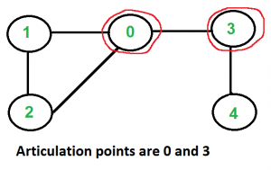
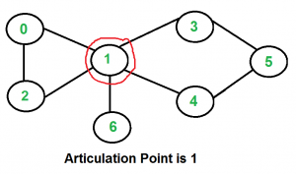
Articulation points
How to adapt the bridge finding algorithm to compute cut vertices (Articulation points)?
The computation of Low is the same, but a different condition is applied to determine which vertices are cut vertices.

Slide 61
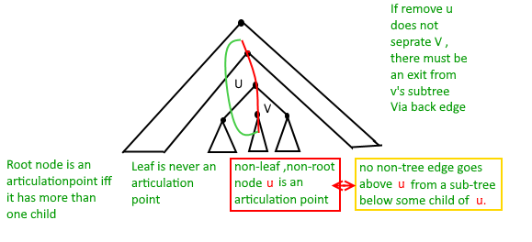
Articulation points
In DFS tree, a vertex u is articulation point if one of the following two conditions is true.
u is root of DFS tree and it has at least two children.
u is not root of DFS tree and it has a child v such that no vertex in subtree rooted with v has a back edge to one of the ancestors (in DFS tree) of u.

Slide 62
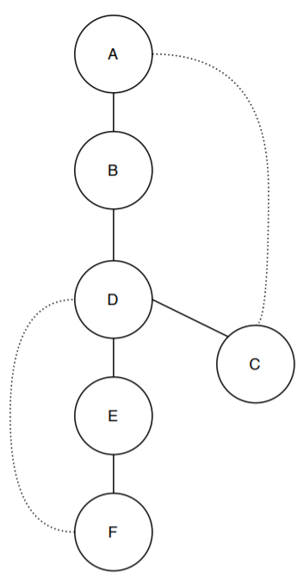
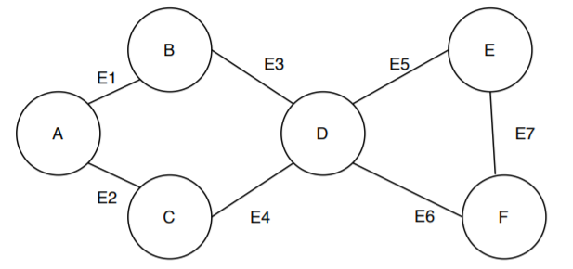
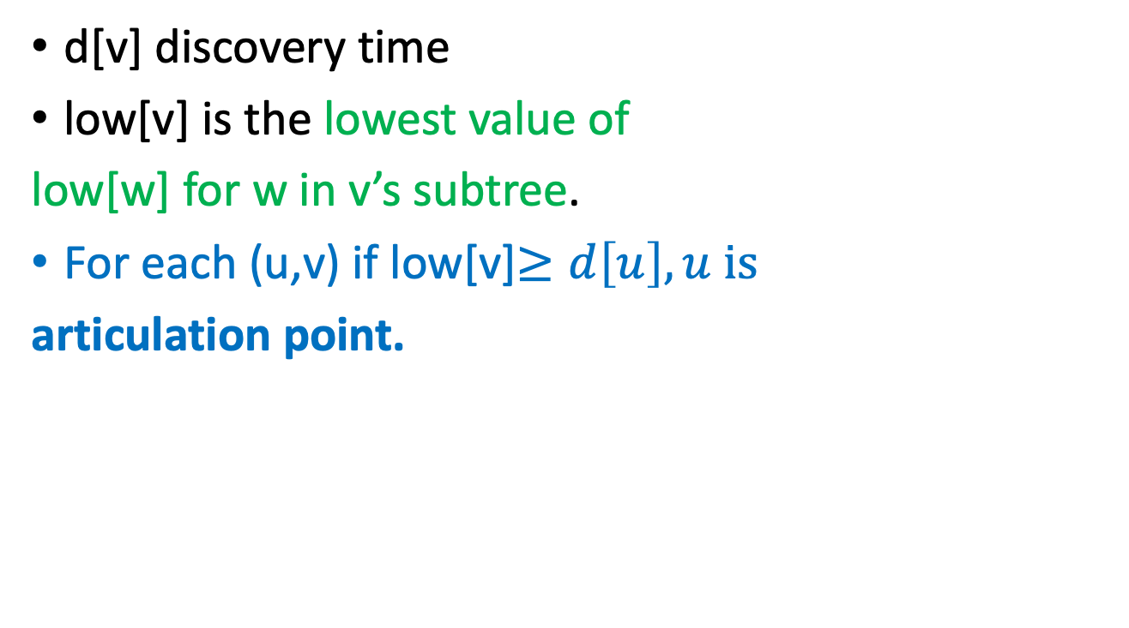
Articulation points
1/1
d[v] discovery time
low[v] is the lowest value of
low[w] for w in v’s subtree.
For each (u,v) if low[v]$≥d\left[u\right], u is$
articulation point.
2/1
3/1
6/1
4/3
5/3

Slide 63
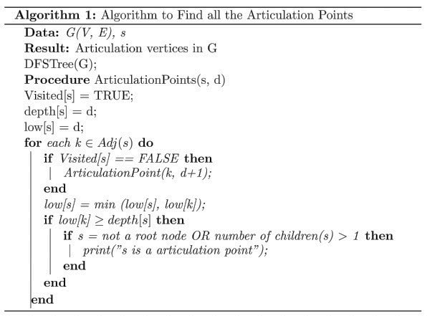
Articulation points
https://www.baeldung.com/cs/graph-articulation-points

Slide 64
主要内容
Concept of Graphs
Review of DFS
Application of DFS
Review of BFS
DFS Algorithm
Complexity
Detection of cycles
Examples of graphs
Graph terminologies
BFS algorithm
Representation of Graphs
Parenthesis Lemma
Detection of Strongly Connected Components
Bridges and two-edge connectivity
Testing bipartite-ness

Slide 65
Breadth-First Search Exploring the world with a bird’s-eye view
Not been there yet
Can reach there in zero steps
Can reach there in one step
start
Can reach there in two steps
Can reach there in three steps

Slide 66
Breadth-First Search Exploring the world with a bird’s-eye view
Not been there yet
Can reach there in zero steps
Can reach there in one step
start
Can reach there in two steps
Can reach there in three steps

Slide 67
Breadth-First Search Exploring the world with a bird’s-eye view
Not been there yet
Can reach there in zero steps
Can reach there in one step
start
Can reach there in two steps
Can reach there in three steps

Slide 68
Breadth-First Search Exploring the world with a bird’s-eye view
Not been there yet
Can reach there in zero steps
Can reach there in one step
start
Can reach there in two steps
Can reach there in three steps

Slide 69
Breadth-First Search Exploring the world with a bird’s-eye view
Not been there yet
Can reach there in zero steps
Can reach there in one step
start
Can reach there in two steps
Can reach there in three steps
World:
explored!

Slide 70
Breadth-First Search Exploring the world with pseudocode
Same disclaimer as for DFS: you may have seen other ways to implement this, this will be convenient for us.
L_{i} is the set of nodes we can reach in i steps from w
Set L_{i} = [] for i=1,…,n
L₀ = [w], where w is the start node
Mark w as visited
For i = 0, …, n-1:
For u in L_{i}:
For each v which is a neighbor of u:
If v isn’t yet visited:
mark v as visited, and put it in L_{i+1}
-
L₀
L₁
Go through all the nodes in L_{i} and add their unvisited neighbors to L_{i+1}
L₂
L₃

Slide 71
BFS also finds all the nodes reachable from the starting point
start
It is also a good way to find all the connected components.

Slide 72
Running time and extension to directed graphs
To explore the whole graph, explore the connected components one-by-one.
Same argument as DFS: BFS running time is O(n + m)
Like DFS, BFS also works fine on directed graphs.
Verify these!
Siggi the Studious Stork

Slide 73
Why is it called breadth-first?
We are implicitly building a tree:
First we go as broadly as we can.
YOINK!
D
L₀
E
A
F
L₁
B
A
E
L₂
F
B
C
D
G
L₃
C
G
Call this the “BFS tree”

Slide 74
Application of BFS: shortest path
How long is the shortest path between w and v?
w
v

Slide 75
Application of BFS: shortest path
How long is the shortest path between w and v?
Not been there yet
Can reach there in zero steps
w
Can reach there in one step
Can reach there in two steps
v
Can reach there in three steps
It’s three!

Slide 76
To find the distance between w and all other vertices v
The distance between two vertices is the number of edges in the shortest path between them.
Do a BFS starting at w
For all v in L_{i}
The shortest path between w and v has length i.
A shortest path between w and v is given by the path in the BFS tree.
If we never found v, the distance is infinite.
L₀
w
L₁
L₂
Modify the BFS pseudocode to return shortest paths!
Prove that this indeed returns shortest paths!
Gauss has no Bacon number
L₃
v
Call this the “BFS tree”

Slide 77
Another application of BFS
Testing bipartite-ness

Slide 78
Pre-lecture exercise: fish
You have a bunch of fish and two fish tanks.
Some pairs of fish will fight if put in the same tank.
Model this as a graph: connected fish will fight.
Can you put the fish in the two tanks so that there is no fighting?

Slide 79
Bipartite graphs
Can color the vertices red and orange so that there are no edges between any same-colored vertices
A bipartite graph looks like this:
Example:
are in tank A
are in tank B
if the fish fight
Example:
are students
are classes
if the student is enrolled in the class

Slide 80
Is this graph bipartite?

Slide 81
How about this one?

Slide 82
How about this one?

Slide 83
This one?

Slide 84
Application of BFS: Testing Bipartiteness
Does DFS work here too?
Color the levels of the BFS tree in alternating colors.
If you never color two connected nodes the same color, then it is bipartite.
Otherwise, it’s not.
A
B
E
F
C
D
G

Slide 85
Breadth-First Search For testing bipartite-ness
Not been there yet
Can reach there in zero steps
Can reach there in one step
start
Can reach there in two steps
Can reach there in three steps

Slide 86
Breadth-First Search For testing bipartite-ness
Not been there yet
Can reach there in zero steps
Can reach there in one step
start
Can reach there in two steps
Can reach there in three steps

Slide 87
Breadth-First Search For testing bipartite-ness
Not been there yet
Can reach there in zero steps
Can reach there in one step
start
Can reach there in two steps
Can reach there in three steps

Slide 88
Breadth-First Search For testing bipartite-ness
Not been there yet
Can reach there in zero steps
Can reach there in one step
start
Can reach there in two steps
Can reach there in three steps

Slide 89
Breadth-First Search For testing bipartite-ness
Not been there yet
Can reach there in zero steps
Can reach there in one step
start
Can reach there in two steps
Can reach there in three steps
CLEARLY BIPARTITE!

Slide 90
Breadth-First Search For testing bipartite-ness
Not been there yet
Can reach there in zero steps
Can reach there in one step
start
Can reach there in two steps
Can reach there in three steps

Slide 91
Breadth-First Search For testing bipartite-ness
Not been there yet
Can reach there in zero steps
Can reach there in one step
start
Can reach there in two steps
Can reach there in three steps

Slide 92
Breadth-First Search For testing bipartite-ness
Not been there yet
Can reach there in zero steps
Can reach there in one step
start
Can reach there in two steps
Can reach there in three steps

Slide 93
Breadth-First Search For testing bipartite-ness
Not been there yet
Can reach there in zero steps
Can reach there in one step
start
Can reach there in two steps
Can reach there in three steps

Slide 94
Breadth-First Search For testing bipartite-ness
Not been there yet
Can reach there in zero steps
Can reach there in one step
start
Can reach there in two steps
WHOA NOT BIPARTITE!
Can reach there in three steps

Slide 95
Hang on now.
Just because this coloring doesn’t work, why does that mean that there is no coloring that works?
I can come up with plenty of bad colorings on this legitimately bipartite graph…
Plucky the pedantic penguin

Slide 96
Some proof required
Make this proof sketch formal!
Ollie the over-achieving ostrich
If BFS colors two neighbors the same color, then it’s found a cycle of odd length in the graph.
A
There must be an even number of these edges
B
E
start
F
C
D
This one extra makes it odd
G

Slide 97
Some proof required
Make this proof sketch formal!
Ollie the over-achieving ostrich
If BFS colors two neighbors the same color, then it’s found a cycle of odd length in the graph.
But you can never color an odd cycle with two colors so that no two neighbors have the same color.
[Fun exercise!]
So you can’t legitimately color the whole graph either.
Thus it’s not bipartite.

Slide 98
What have we learned?
BFS can be used to detect bipartite-ness in time O(n + m).

Slide 99
Recap
Depth-first search
Useful for topological sorting
In-order traversals of BSTs
Detect Cycle
Find SCC
Find bridges and two connected components
Breadth-first search
Useful for finding shortest paths
Also for testing bipartiteness
Both DFS, BFS:
Useful for exploring graphs, finding connected components, etc
Complexity O(m+n).

Slide 100
Still open (next few lectures)
We can now do some graph structure analysis
SCCs, cycles, bridges, two-connected components.
How can we conduct more complex graph structure analysis?
Is it possible to finding 3-connected components in O(m+n)?
DIVIDING A GRAPH INTO TRICONNECTED COMPONENTS, J. E. HOPCROFTf AND R. E. TARJAN
SIAM J. COMPUT. Vol. 2, No. 3, September 1973
More complex graph structure analysis?
Find k-cores
Find k-VCCs

